Slide 1
Fit Track
Flutter App Presentation
Authors | Marina Lavrova, Leonid Merkulov, Nadezhda Tarubarova

Slide 2
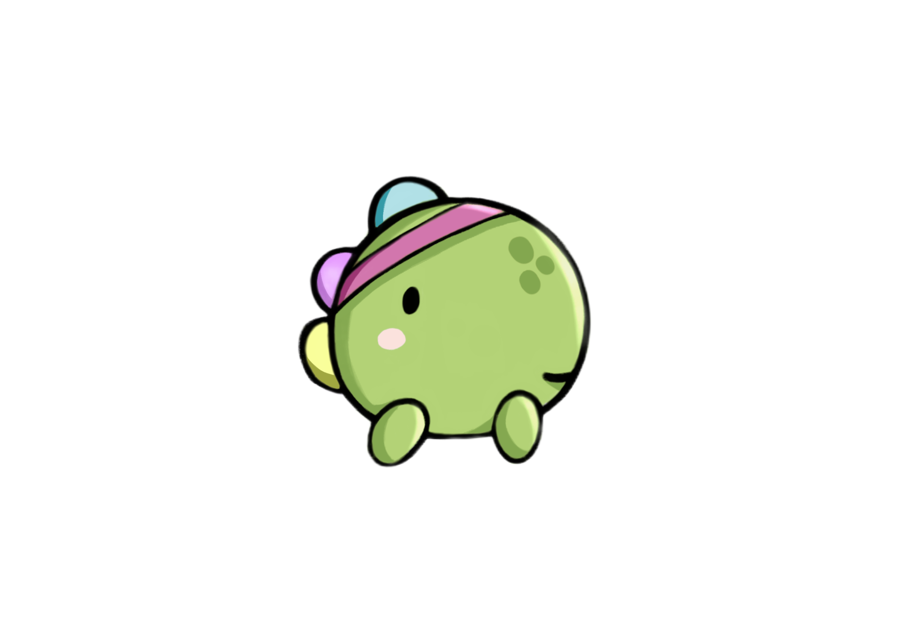
Problem
Many applications for creating your own workouts for the gym have a rather incomprehensible user interface and are also paid
Apps do not always give users an opportunity to create a convenient workout with their own exercises

Slide 3
Our Solution
Fit Track App helps people create their workout without limitations, allowing each user to make the workout according to their wishes.
Like any good workout app, it helps people keep their body toned and stay healthy.

Slide 4
Functionality
Users can create their workout, in which sections can be created (for example, by muscle group).
Within the sections, the user can create exercises.

Slide 6
Functinality
Exercise planner
Timer, Settings
Workouts, sections, and exercises can be created, deleted, and modified. The user can save their workout and see a list of all workouts in the history.
The user can also start his workouts where he performs exercises one by one. To start an exercise, the user has to press the start button, and there is an option to pause the exercise.
The main screen has a navigation bar that takes you to settings, where you can switch themes (light/dark) and go to a timer to set the time (for example, for plank or stretching).

Slide 7
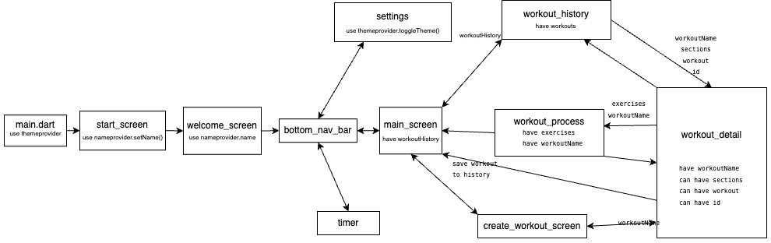
Architecture diagram

Slide 8
Problems during development
Workout structure
During the development process, there were problems with maintaining the workout structure and changing the theme.
Workout process
Also out team faced the problem with the workout process (starting the next exercises and sections), and setting the timer scroll.
These problems arose due to a lack of experience, but with the help of various internet sources and ChatGPT, all problems were successfully solved.

Slide 9
THANK YOU!
Do you have any questions?
@mc_lavrushka
@merkulov_leonid
@laseiiine

